Slide 1
Accelerating Public Health Hiring: A QI Pilot to Reduce Time to Hire Through Practical Tools and Manager Engagement
Ryan Jury, RN, MBA – Acting Senior Deputy Public Health Division Director, North Carolina Department of Health and Human Services
August 20, 2025

Slide 2




Public Health Improvement
Just Do It
Some projects don't need extensive discussion before implementation.
Engagement
Process to get teams involved and bought into the project
Framework
Data collection methods and communication of results
Momentum
Using lessons learned to tackle other improvement needs

Slide 3


Slide 4
"If you want to go fast, go alone; if you want to go far, go together“
-African proverb

Slide 5
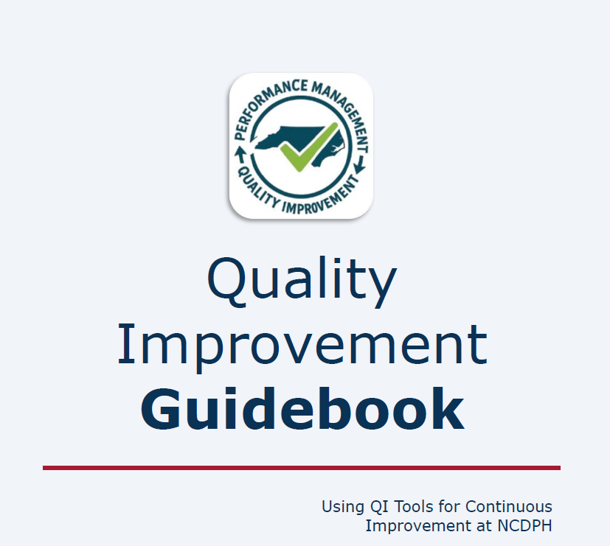

Slide 6
Momentum – Problem Statement
  Increase the distance that each table’s paper airplanes will fly

Slide 7
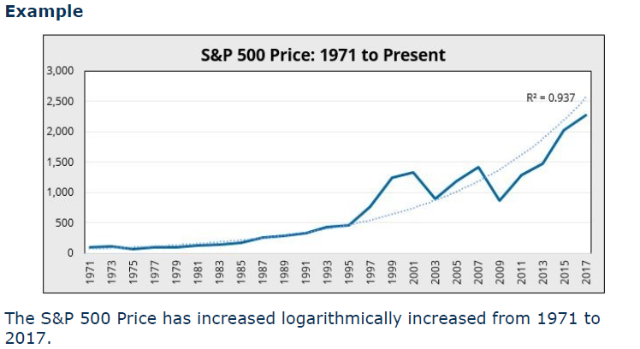
Momentum – How are we doing?
Activity:
Each table should fold a paper
airplane.
Observations? (5 Why)

Slide 8
Momentum – Brainstorm
What potential solutions could be used to solve the problems observed?

Slide 9
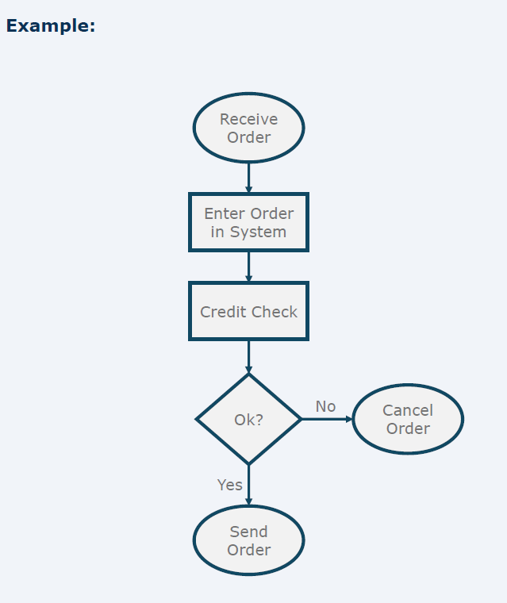
Momentum – Current State
Start with a Piece of Paper:
  Use a standard 8.5 x 11-inch sheet of paper.
Fold the Paper in Half Lengthwise:
  Fold the paper in half lengthwise (hotdog style) and then unfold it. This creates a crease down the center.
Fold the Top Corners to the Center Crease:
  Take the top right corner and fold it down to the center crease.
  Repeat with the top left corner, creating a triangle shape at the top.
Fold the Top Edges to the Center Crease:
  Take the new top right edge and fold it to the center crease.
  Repeat with the top left edge, forming a narrower triangle.
Fold the Plane in Half:
  Fold the plane in half along the original center crease, with the folds inside.
Create the Wings:
  Fold down one side to create a wing, aligning the edge with the bottom of the plane.
  Repeat on the other side to create the second wing.
Adjust the Wings:
  Make sure the wings are even and adjust them to ensure the plane is balanced.

Slide 10
Momentum – How are we doing?
Activity:
Each table should fold a paper
airplane.
Observations? (5 Why)

Slide 11
Momentum – Brainstorm
What potential solutions could be used to solve the problems observed?

Slide 12
Momentum – Brainstorm
Tips for Better Flights:
  Crease Firmly: Make sure all folds are crisp and firm.
  Symmetry: Ensure both sides are symmetrical for better flight performance.
  Fail Fast: Make small adjustments to improve its flight.

Slide 13
Momentum – How are we doing?
Activity:
Each table should fold a paper
airplane.
Observations? (5 Why)

Slide 14
Implementation in Public Health Practice

Slide 15

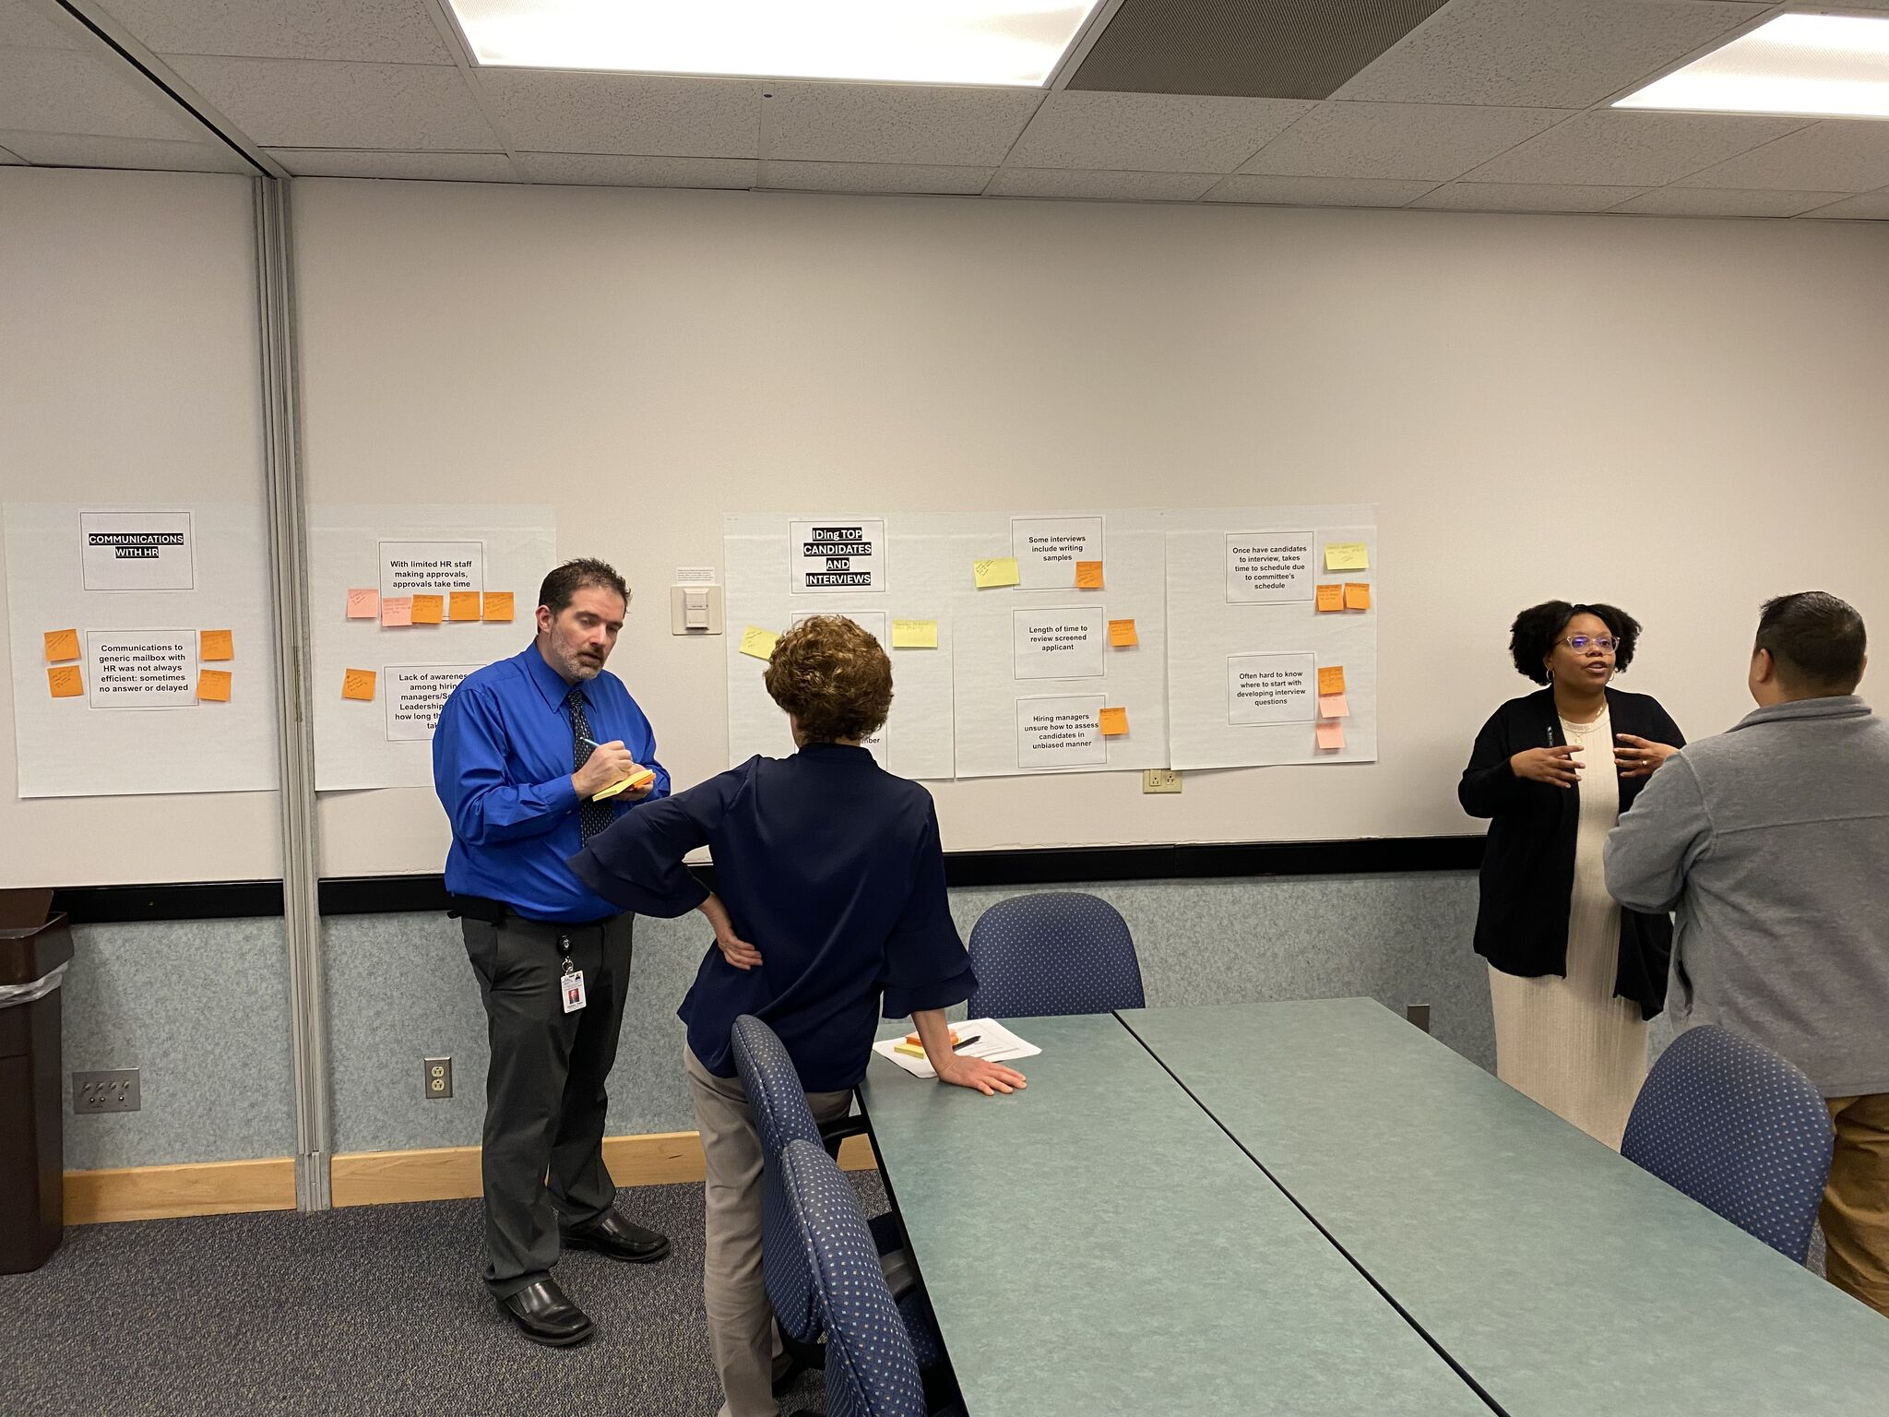


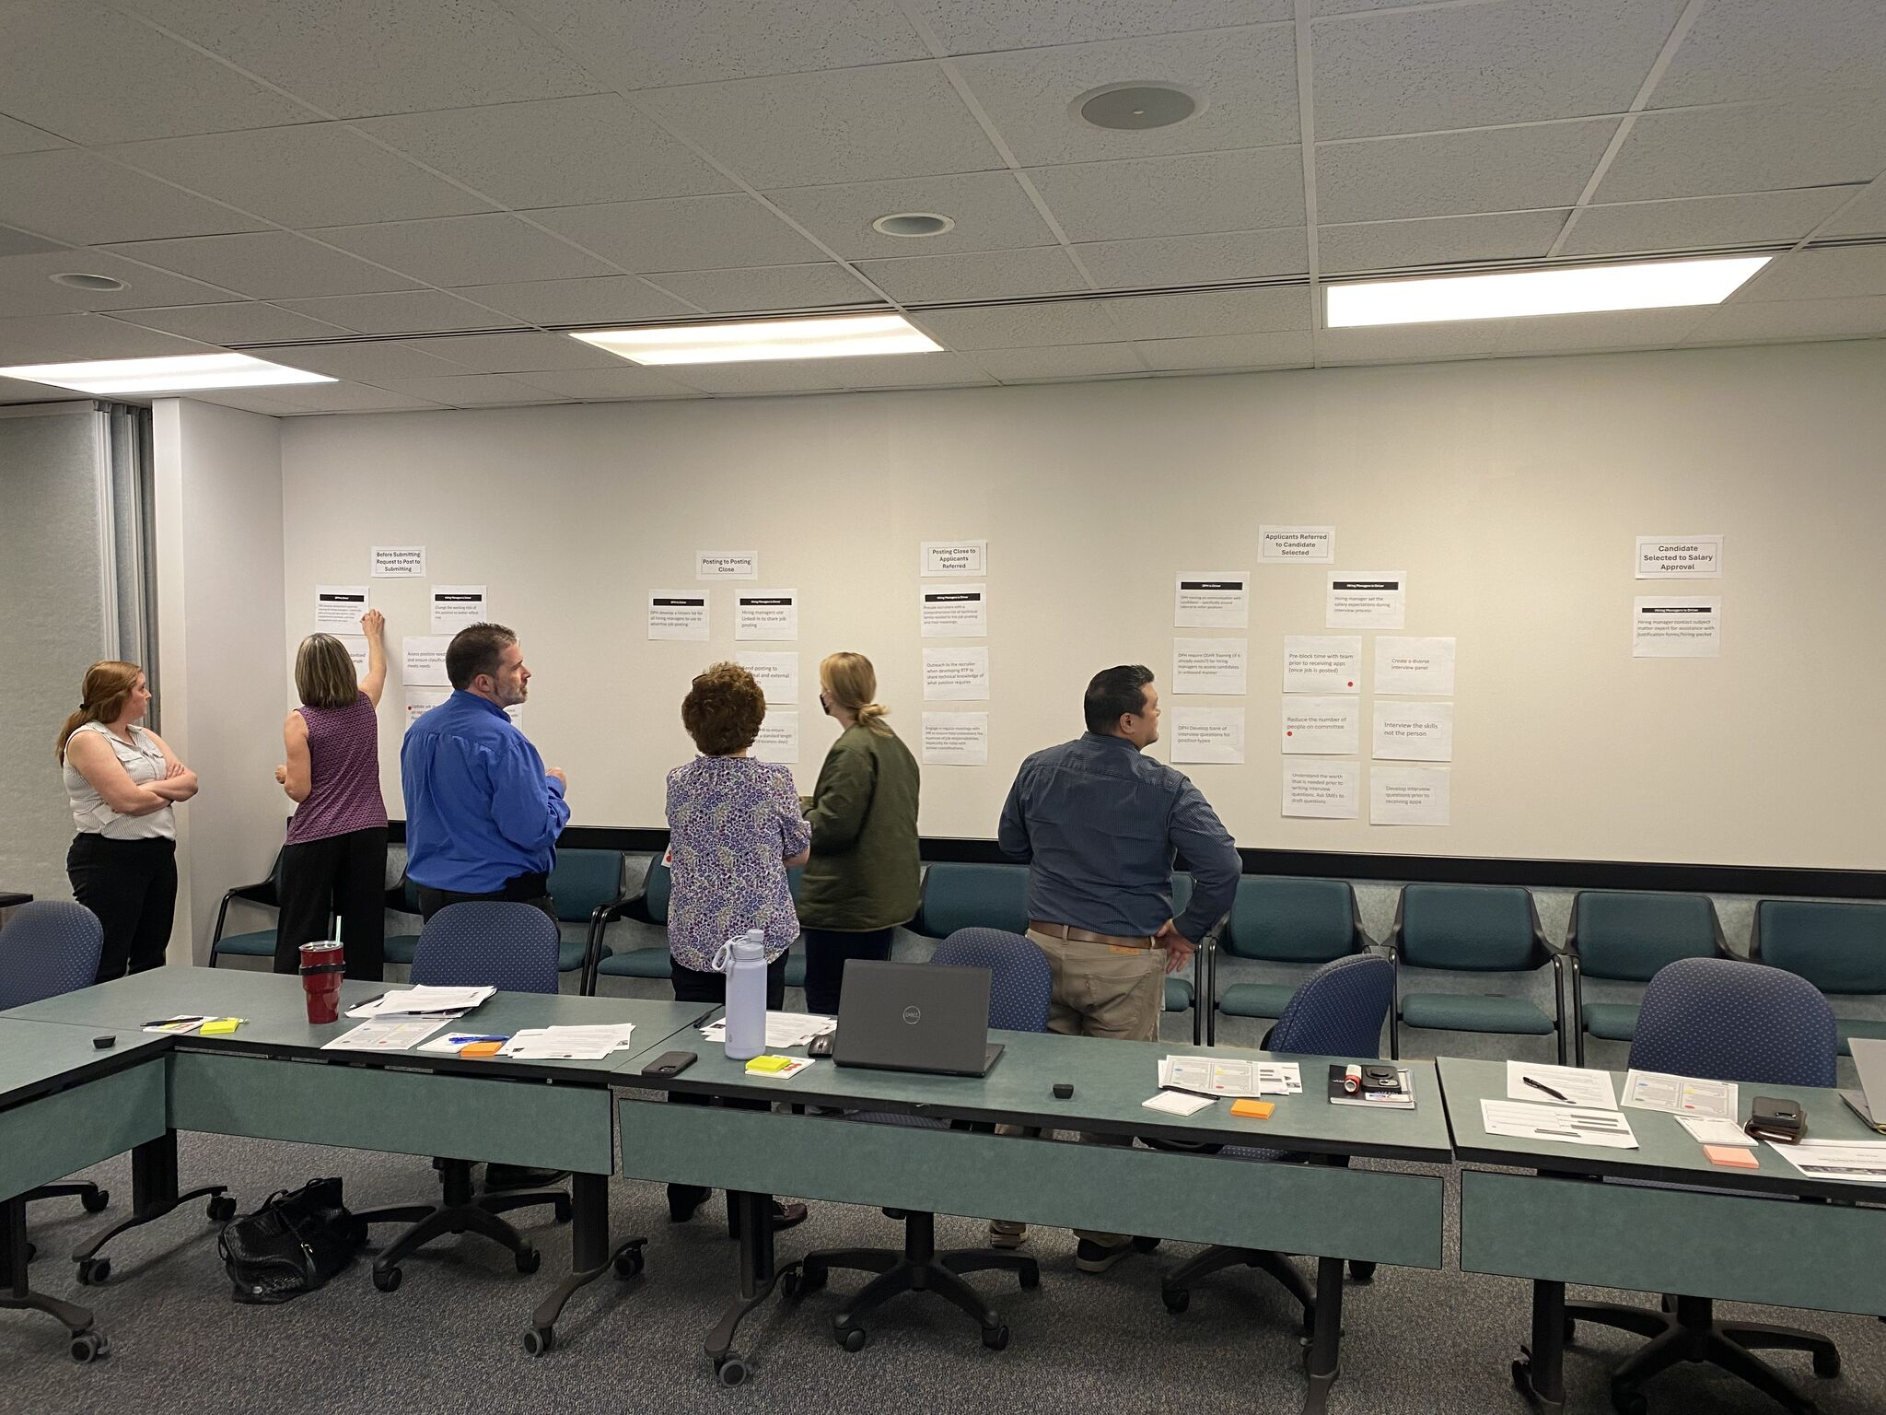
Project Timeline
Sept 2023 – Nov 2023
Nov 2023 – April 2024
April 2024 – Aug 2024
Aug 2024 – Dec 2024
Accenture Current State Analysis on DPH Time to Hire
Development of QI Pilot Project Proposal
Stakeholder Engagement with CDI and DMT
Referral of QI Project to Quality Improvement Council
QI Project Team Kick Off with CDI
Identification of Possible Solutions – DPH Driver
Voting on Action Plan
Development of 3 Time to Hire Tools
Implement of Time to Hire Tools with CDI Hiring Managers
Tracking Time to Hire Data
Feedback from Hiring Managers

Slide 16
Project Deliverables
When used in Hiring Process
Hiring Process Metric Effected
Tool 1: Recommendations for updated job descriptions
Overview document that defines process for how and when to update job descriptions.
Walks though expectations of hiring managers and shares tips/tricks
Step 1: # of Days from RTP to posting
Step 3: # of Days from posting closing to applicants referred
Step 4: # of Days from applicant referred to candidate selected
Step 5: # of Days from candidate selected to salary approval
Step 7: # of Day from verbal offer to offer accepted
Step 1: Hiring manager Developing RTP
Tool 2: Recommendations for pre-blocking time for candidate interviews
Defines expectations of hiring managers for when to ID interview committee members (within 2 days of job posting) and putting holds on their calendars for potential interview times
Step 2: Position Posted
Step 4: # of Days from applicant referred to candidate selected
Tool 3: Bank of Interview Questions
Intro/Instructions for Hiring Managers
Bank of interview questions group by categories
Step 4: Hiring manager conducting Interviews
Step 4: # of Days from applicant referred to candidate selected

Slide 17
Project Outcomes
Cumulative Average Number of Day Over Target through Step 5
QI Pilot: 49.03 Days Control: 90 Days
Effected by Time to Hire Tools
=
* Counter offer required salary changes

Slide 18
Deep Dive into Vacant Positions
Status of Vacant Positions

Slide 19
Qualitative Data from Project Hiring Managers
Issues that extend hiring process
Root Cause
HR SharePoint/NEOGOV Recruitment Guide not up-to-date
Outdated Hiring Manager Resource Information
Problem
Lack of guidance on navigating reposting process when needed (no qualified candidates or rejected offer)
Hiring Managers are encountering challenges in the hiring process that extend the hiring process – and the longer it takes to fill a position, the more likely hiring managers are to experience hiring hesitancy
Delays due to undefined processes
HMs unclear how to navigate salary negotiations and budgeting issues
Limited number of/Loss of qualified candidates
Delays/Extended time to hire timeline (specifically after step 4)
Position not budgeted at or above median of salary range

